Slide 1


RAJARSHI SHAHU COLLEGE OF ENGINEERING DEPARTMENT OF INFORMATION TECHNOLOGY
Project Based Seminar (Oral) Presentation
On
“Emotion Analysis of Human Being Through Facial Expression”
By
71928394K Divya Nitin Gohel
71822302M Prajakta Chindhe.
71928389C Gauri Gad
71928386J Shubhangi Bhosale.
Guide
“Mrs. Geetanjali Mate”

Slide 2
CONTENT
Introduction
Literature Survey
System Architecture
Database Description
Algorithm
Future Output.
Conclusions
References

Slide 3
PROJECT DETAILS
PROJECT TITLE: Emotion Analysis Through Facial Expressions.
PROJECT DOMAIN: Artificial Intelligence and Image Processing.
POJECT GROUP MEMBER:
71928394K Divya Gohel.
71822302M Prajakta Chindhe.
71928389C Gauri Gad.
71928386J Shubhangi Bhosale.

Slide 4
Why Emotion Analysis?
The motivation behind choosing this topic specifically lies in the huge investment large companies do in feedbacks and surveys but fail to get equitable response on their investment.
Emotion analysis through facial gesture is a technology that aims to improve product and services performance by monitoring customer behavior to certain products or service staff by their evaluation.

Slide 5
PROBLEM STATEMENT
“Emotion Analysis through facial Expression”
NEED OF EMOTION ANALYSIS:
1. Companies.
2. Health Care.
3. Automotive Industry.
4. Video Game testing.

Slide 6
AIM AND OBJECTIVE
AIM:
State of Person.
Non Verbal Communication.
Standardized parentages of several emotional states.
OBJECTIVE:
Recognize the emotion.
Understand reaction of customer.
Human Analysis and Problem Solving.

Slide 7
INTRODUCTION
Facial expressions play a key role in nonverbal communication.
Emotions like happy, sad, anger, disgust, fear, surprise etc.
Algorithm Used:
1.Face Detection using Violas Jones.
2.Deep Convolutional Neural Network.
Determine the different degree of the emotions.

Slide 8
LITERATURE SURVEY
Author: Rajesh Kumar G ,Ravi Kant Kumar, Goutam Sanyal
Publication: Facial Emotion Analysis using Deep Convolution Neural Network
Publication year:2017
Classification Method: Convolutional Neural Network
Result: 90+%

Slide 9
LITERATURE SURVEY
SR. NO. | REFERENCE TITLE | YEAR | DESCRIPTION
1. | Facial Emotion Recognition of Students using Convolutional Neural Network. | 2019 | In this paper, we create a system that recognizes students’ emotions from their faces. Our system consists of three phases: face detection ,crop and normalization and emotion recognition using 7 layer CNN on FER 2013 database with seven types of expressions

Slide 10
LITERATURE SURVEY
SR. NO. | REFERENCE TITLE | YEAR | DESCRIPTION
2. | Facial Emotion Recognition using Matlab. | 2017 | Matlab combines a desktop environment tuned for iterative analysis and design processes with a programming language that expresses matrix and array mathematics directly.

Slide 11
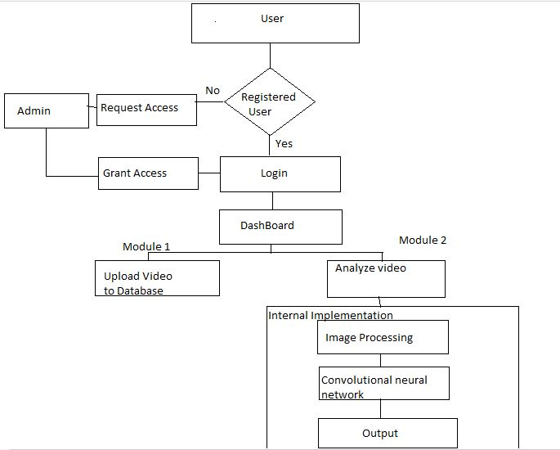
System Architecture

Slide 12
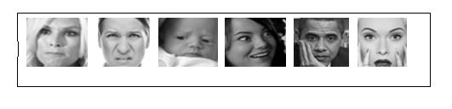
Dataset Description
The database holds of [48x48] pixels of gray scale pictures of human faces. The faces are automatically processed, so that it holds up round a comparably equivalent volume of face space in all images. The prime task is to place each face in view of the emotions of one of seven classes (0: Happy, 1: Sad, 2: Surprise, 3: Angry, 4: Disgust, 5: Fear, 6: Neutral). Thus, database exists in the form of emotion and its matching pixels array
Some example of dataset is as shown belong

Slide 13
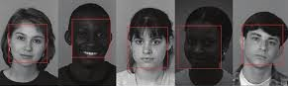
Algorithm
Image processing
Step 1: Get input from user.
Step 2: Face-detection using Viola Jones algorithm
Step 3: Taking maximum area face among all faces.

Slide 14
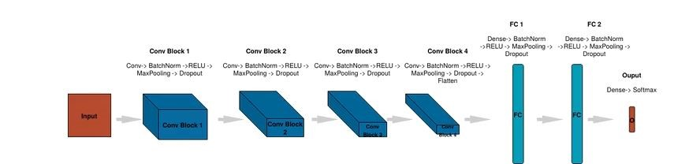
Convolutional Neural Network
In recent times, convolutional neural networks (CNN) have confirmed inspiring performance in plentiful computer vision tasks. Though, excessive performance hardware is obviously very important for the use of CNN models due to the great computation difficulty, which forbids their additional extensions. Our prime objective in this paper is to utilize CNN architectures according to our classification requirement parameters to achieve better accuracy.

Slide 15
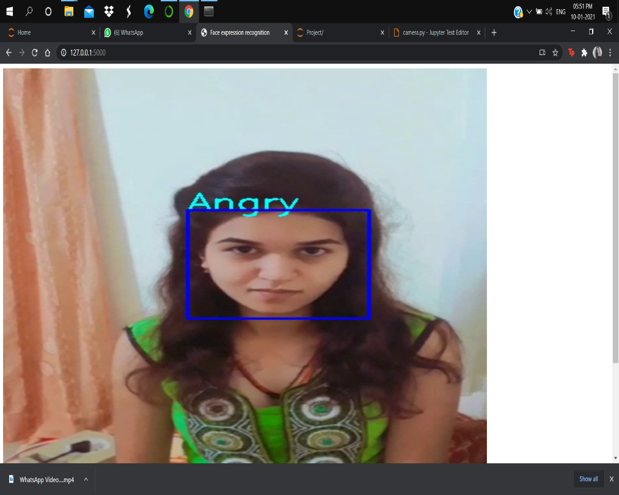
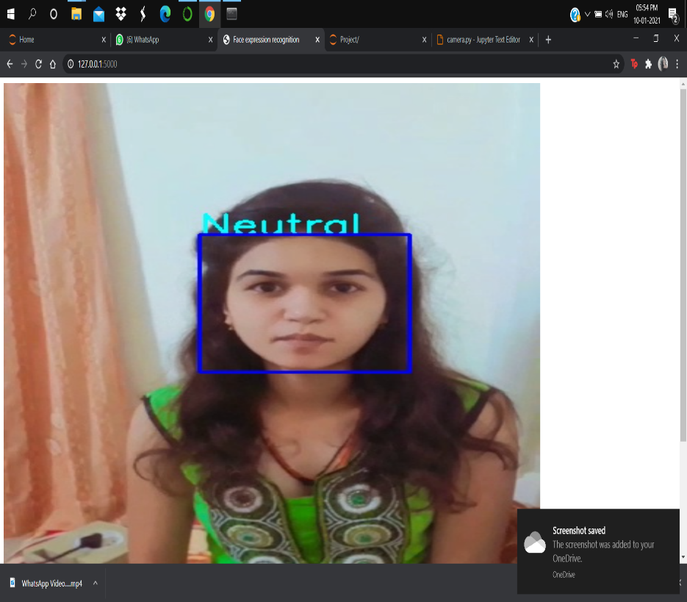
Actual Output

Slide 16
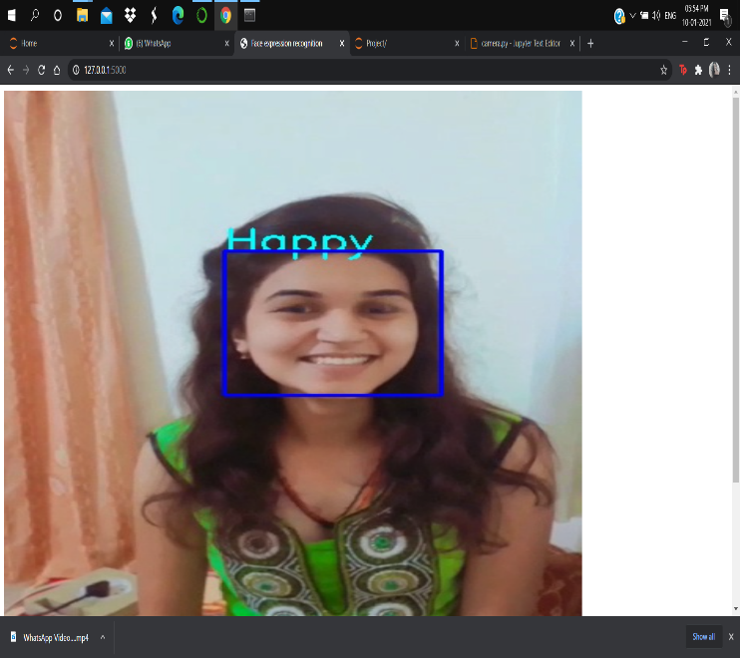
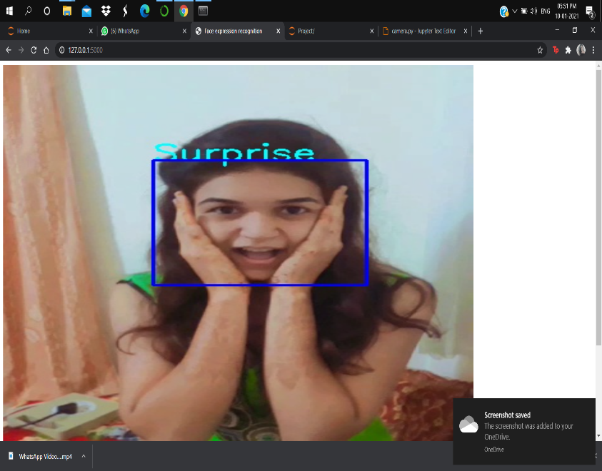
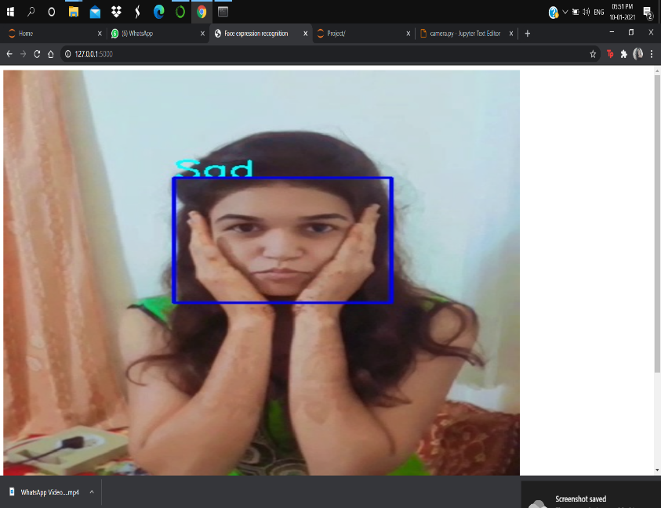
Actual Output

Slide 17
CONCLUSION
Determines the state, mood and current feeling of a person through nonverbal communication.
We have used convolution neural network with 9 layers, for training and classification of 7 types of standard emotions.

Slide 18
REFERENCES
https://medium.com/@RaghavPrabhu/understanding-of-convolutional-neural-network-cnn-deep-learning-99760835f148
https://www.slideshare.net/franzonadiman/applications-of-emotions-recognition
https://towardsdatascience.com/the-intuition-behind-facial-detection-the-viola-jones-algorithm-29d9106b6999

